Slide 1
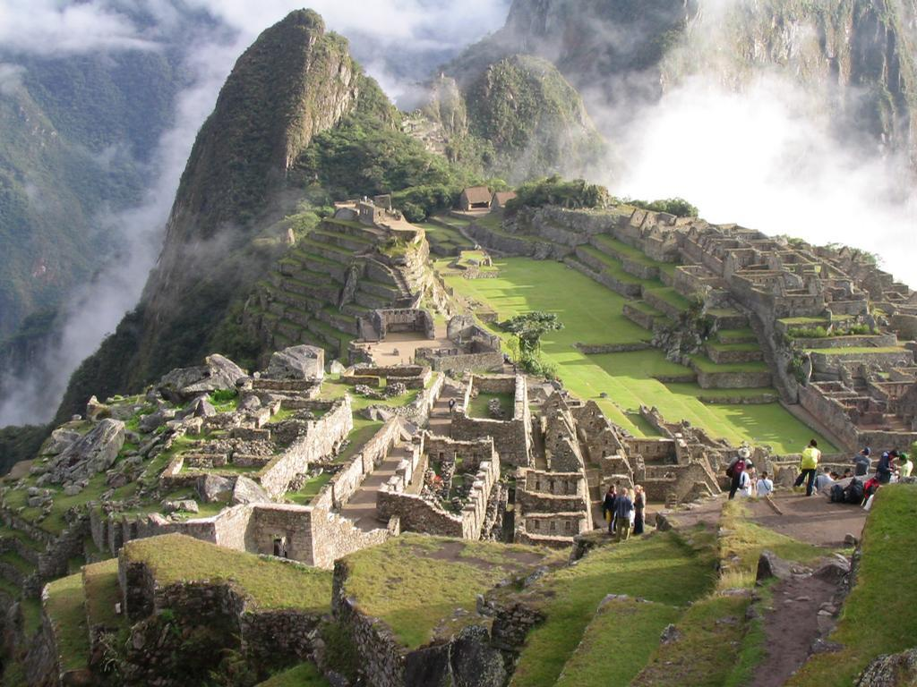
Inca Civilization
Machu Piccu

Slide 2
http://www.youtube.com/watch?v=uT4ySwoh27Q

Slide 3
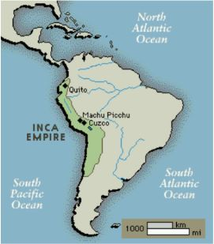
Location
The Inca controlled an empire in the Andes Mountain region of South America
Capital: Cuzco
Notes:
Cuzco: in present-day Peru

Slide 4
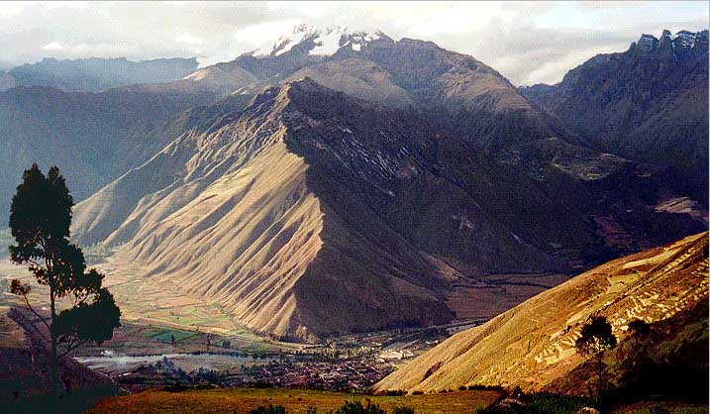
fast expansion, large empire
Notes:
In 90 years the empire grew into a stretch of land that covered over 3,000 miles from north to south

Slide 5
Government
The Sapa Inca (“Great Emperor”) had absolute power.
The emperor claimed to be the “son of the sun” (divine ruler).
The emperor was also the empire’s religious leader.

Slide 6
Reason for expansion
The usual motivations for economic gain and political power did play a role.
The cult of the ancestors, however, was just as influential.

Slide 7
Deceased rulers were mummified and treated as intermediaries with the gods.
Practice of royal ‘split inheritance’
Notes:
Spilt inheritance gave political power and titles of the deceased ruler to the successor, while wealth and possessions remained under the control of the dead leader.

Slide 8
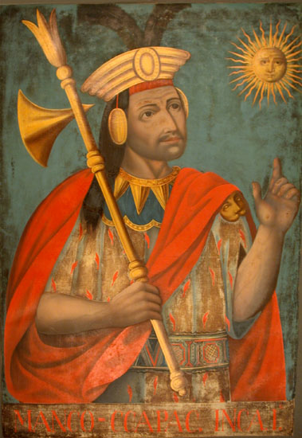
To ensure that he would have a place for eternity each new ruler needed to expand the empire to gain lands and wealth for the afterlife.

Slide 9
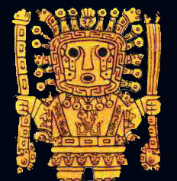
Religion
Less brutal than Aztecs, but many similarities
The Inca were polytheistic.
The primary god was Inti, the sun god.

Slide 10
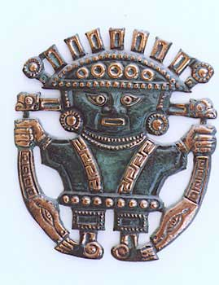
Religion
Inca believed in reincarnation.
Royal family descended from sun god
“Virgins of the Sun”
Notes:
Some women were selected as servants for the temples

Slide 11
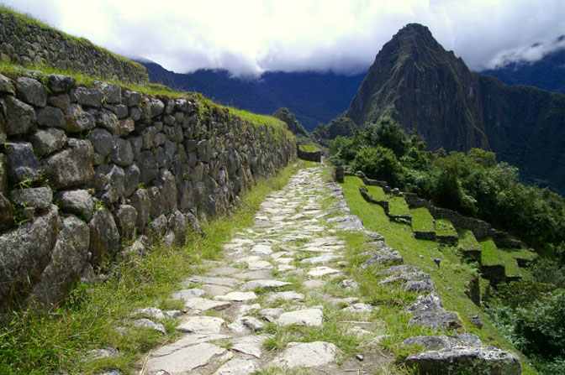
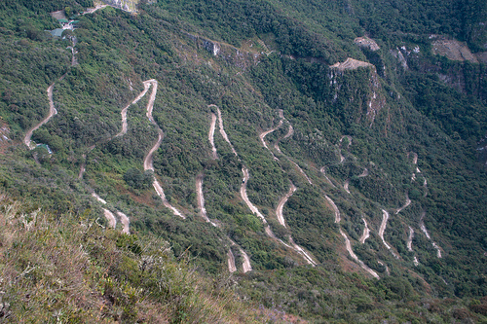
Uniting the Empire
The Inca built a massive road network through mountains and across rivers and gorges.

Slide 12
Way stations
inns, storehouses and supply centers for the Inca armies
relay points for the system of runners who carried messages throughout the empire
Notes:
Way stations: were placed about a day’s walk apart; A message from the extreme south would reach the extreme north in about 9 days.

Slide 13
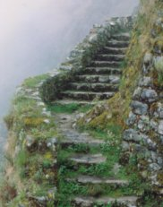
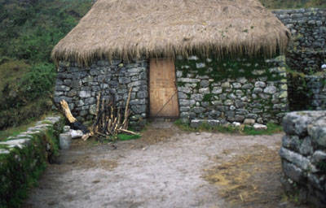
stone steps
restored way station

Slide 14
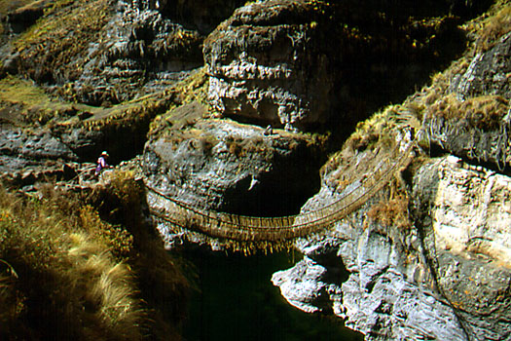

Slide 15
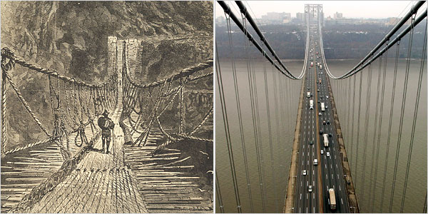
Notes:
Inspiration for modern bridges

Slide 16
Economy and organization
Government officials arranged marriages.
Each family in a community was assigned a specific job.
The government organized mandatory public service building projects, called mita.
The state claimed all resources and redistributed them (totalitarian welfare state).

Slide 17
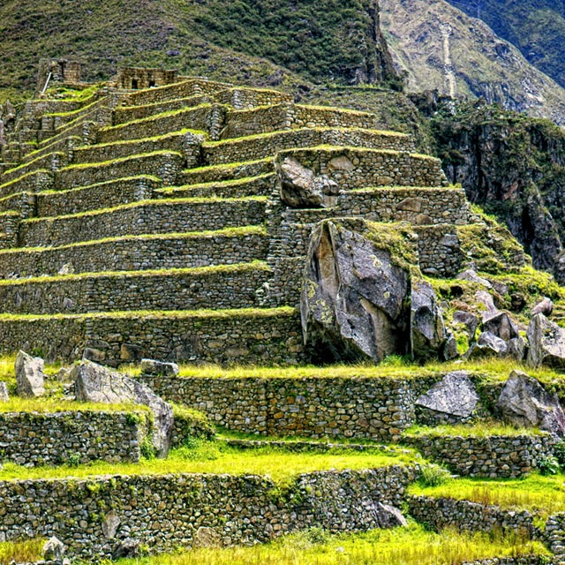
Terraced agriculture
Notes:
Extensive, irrigated agricultural economy that adapted to the rugged terrain of the Andes

Slide 18
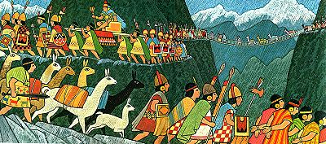
Domesticated largest available animals: llama, alpaca

Slide 19
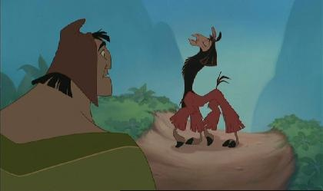

Slide 20
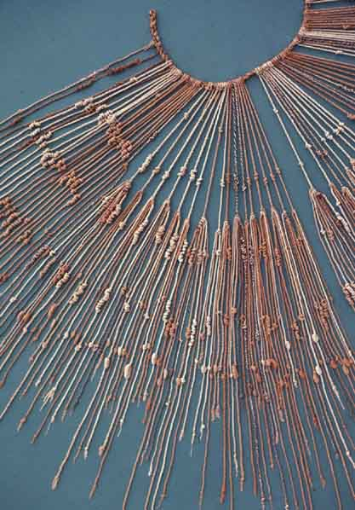
Quipu
Officials collected taxes and enforced laws
No written language
“Quipu” record-keeping system of colored ropes and knots.
Notes:
the quipu was adequate enough for the Incas to maintain detailed records of ledgers, inventories, and even census records.

Slide 21
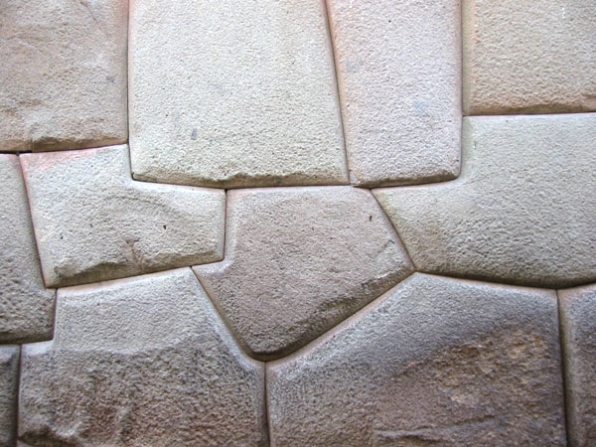
Other Advances: Stonework
Notes:
The Inca constructed stone temples without using mortar, yet the stones fit together so well that a knife would not fit between them.

Slide 22
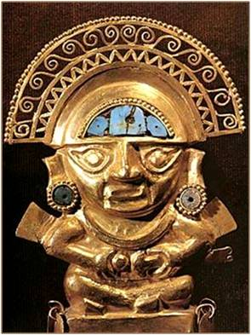
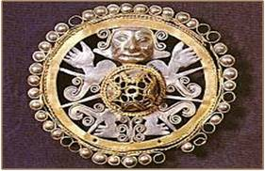
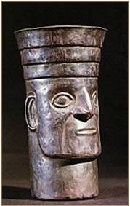
Artistic Achievements: gold and silver work

Slide 23
Medical Advances
The Inca performed successful skull surgery.
The Inca also used medicines to make patients unconscious during surgery

Slide 24
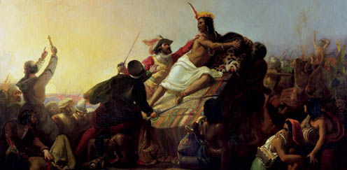
Fall of the Inca
Spanish conquistadors led by Francisco Pizarro that brought about the fall of the Inca Empire, through warfare and smallpox

Slide 25
Comparing Aztec and Inca
Both were successful with imperial and military organization.
Both had intensive agriculture organized by the state that created a food surplus.
Both developed systems of roads and advanced engineering techniques
Both were polytheistic and made human sacrifices to the gods
Both were defeated by the Spanish

Slide 26
Aztec or Inca?
Developed a writing system.
Sacrificed more humans – reason for conquests
Controlled more land – reason for conquests

Slide 27
Answers
Aztecs developed a writing system and the Incas did not.
Aztecs sacrificed more humans – reason for conquests
Incas controlled more land – reason for conquests

